Slide 1
BCSE308L / BCSE308P • COMPUTER NETWORKS
FINAL COURSE
PROJECT REVIEW
Predictive vs. Reactive Load Balancing in SDN: An Empirical Study under Flash-Crowd Traffic
Team ID: single-member project
Team member & register number: Fida M S — 24BAI0180
Programme: B.Tech CSE (AI & ML), SCOPE
Faculty mentor: Prof. Yoganand S
Review date: 28 October 2026
SDN load balancing • Mininet / Ryu / OpenFlow 1.3

Slide 2
Project snapshot
PROBLEM
SOLUTION
OUTCOME
When a flash crowd hits, many requests arrive at once at a virtual IP that sits in front of a pool of servers. The servers are single threaded, so poor routing pushes up the tail latency that users feel. The usual claim is that a load aware SDN controller will beat plain round robin.
We built five controller policies on one Mininet and Open vSwitch testbed: round robin, weighted round robin, reactive least load, an EWMA predictor and a capacity aware policy. All of them were tested under the same flash crowd, including a real 1998 World Cup trace.
The byte rate signal the controller sees points the wrong way for compute bound servers, so the reactive policies lose to round robin. The one policy that wins is capacity aware: it cuts P99 latency from about 98ms to 48.8ms under steady load.
At-a-glance
Target metric
P95 / P99 request latency and success rate
Environment
Mininet 2.3.1, Open vSwitch 2.17, Ryu 4.34
Status
Implemented, tested and evaluated (7-run mean ± SD)
Contribution
A careful comparison of the signals a controller can see, plus one policy that beats round robin
02

Slide 3
Problem statement, objectives and scope
PROBLEM STATEMENT
OBJECTIVES
A flash crowd sends many short requests at once to a virtual IP in front of three backends. The servers are single threaded, so poor routing drives up the P95 and P99 latency and can start dropping requests.
Common wisdom says a load aware controller should beat round robin. We test whether that actually holds, and which signal it depends on.
Build a reproducible SDN load-balancing testbed with pluggable controller policies.
Compare reactive load-aware policies against round-robin under flash-crowd traffic.
Explain the measured outcome mechanistically, then design a policy that improves on round-robin.
SCOPE AND ASSUMPTIONS
SUCCESS CRITERIA
Included: L3/L4 load balancing at one OpenFlow switch, three backends, four clients, emulation only.
Assumptions: single-threaded backends, a fresh TCP connection per request, per-server service times known to the capacity-aware policy.
A policy is better only if it lowers P95/P99 at equal-or-higher success rate, repeatably.
Every number reported as mean ± SD over seven runs per configuration.
03

Slide 4
Background and related work
NETWORKING CONCEPTS
EXISTING APPROACHES
SDN control/data-plane split; OpenFlow 1.3 flow tables with match/action rules; idle and hard timeouts; port statistics and flow-removed events as load signals; NAT-style VIP rewriting; TCP setup and retransmission; tail latency (P95/P99).
Round-robin / weighted RR: simple, stateless, no load feedback.
Reactive least-load and EWMA power-of-two: route on a measured load signal; standard in SDN LB work.
Prequal (NSDI 2024) and least-connections proxies (HAProxy): use latency or in-flight counts, not byte rate.
Related-work comparison
Approach | Load signal | Decides per | Main limitation
Round-robin | none | request | ignores server heterogeneity
Least-load / EWMA | port byte-rate | 2 s poll / request | signal inverts for compute-bound servers
Capacity-aware (ours) | known service time | client | needs service times; assumes load is light enough
04

Slide 5
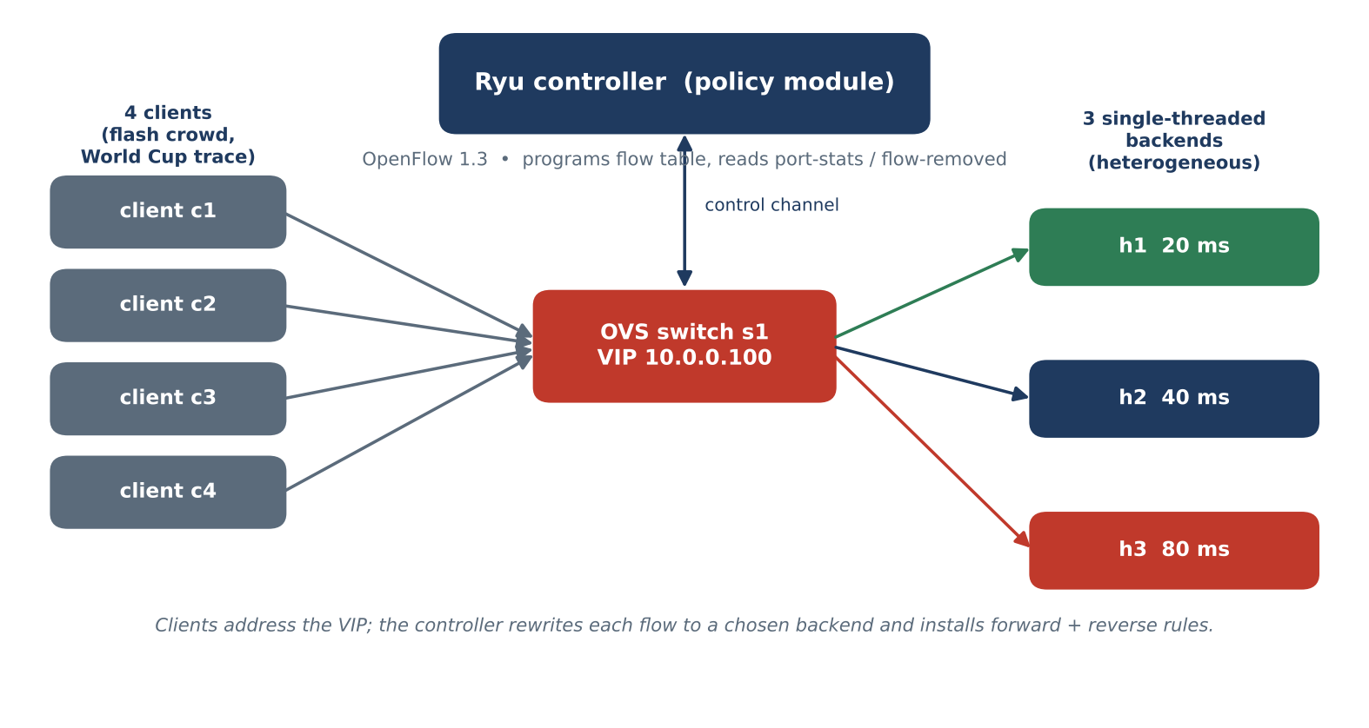
Proposed system architecture
ARCHITECTURE DIAGRAM
COMPONENTS
OVS switch with VIP 10.0.0.100; Ryu controller runs one swappable policy module.
Three single-threaded backends; four flash-crowd clients.
DESIGN DECISIONS
Mininet for control and repeatability; OpenFlow 1.3 for port-stats / flow-removed signals; one switch so routing choice, not topology, drives the result.
NETWORK PARAMETERS
VIP 10.0.0.100; servers at 20/40/80 ms; 4 clients; 10 Mbit / 1 ms links; poll 2 s; 480 requests per run.
05

Slide 6
Implementation and configuration
TOOLS AND ENVIRONMENT
IMPLEMENTATION STEPS
Mininet 2.3.1, Open vSwitch 2.17, Ryu 4.34, Python 3.10.
Custom slow HTTP server, load generator, and analysis scripts; all policies share one controller framework.
1. Build topology: 1 switch, 3 servers, 4 clients, VIP.
2. Start the chosen Ryu policy; install table-miss to controller.
3. On first packet to VIP, pick a backend and install forward + reverse flows.
4. Replay flash-crowd trace; collect per-request latency; aggregate over 7 runs.
KEY CONFIGURATION / CODE
DEMO EVIDENCE
Capacity-aware selection (per client):
proj_i = (clients_on[i] + 1) x service_ms[i]
assign client to argmin proj_i, then pin it there.
Forward rule rewrites VIP -> backend MAC/IP; reverse rule restores the VIP.
Controller logs show per-flow assignment and clients_on; for 20/40/80 ms it settles on 3 clients to the fast server, 1 to the medium, 0 to the slow one.
06

Slide 7
Test plan and validation
TEST SCENARIOS
EXPECTED RESULTS
OBSERVED RESULTS
Normal: steady request arrivals at moderate rate.
Flash crowd: bursty arrivals (World Cup trace shape).
Heterogeneous pool stress: 20/40/80 ms backends.
Load-aware policies should lower tail latency vs round-robin if the signal is correct.
Success rate must stay at 100% for a policy to count as better.
Reactive byte-rate policies did NOT beat round-robin; several were far worse.
The capacity-aware policy beat round-robin on every metric at 100% success.
Test matrix
Policy | Burst P99 (ms) | Steady P99 (ms) | Success % | Verdict
Round-robin | 98.9 ± 2.5 | ~96 (median) | 100 | baseline
EWMA P2C | 111.2 ± 36.6 | 111.3 ± 22.3 | 100 | worse, unstable
Response-time | 240.6 ± 0.5 | 188.7 ± 33.9 | 99 | stable but worse
Capacity-aware | 66.0 ± 11.4 | 48.8 ± 0.6 | 100 | wins
07

Slide 8
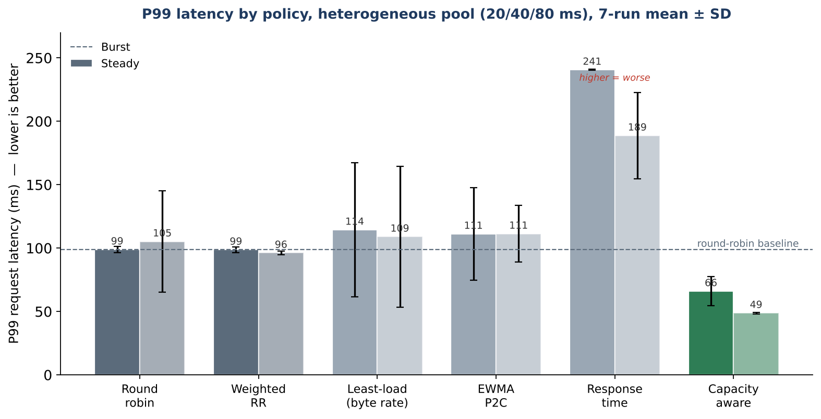
Results and performance analysis
RESULTS CHART / TABLE
KEY FINDING 1
The reactive byte rate signals mislead the controller. Least load and EWMA sit at or above the round robin P99 line, and the connection count version collapsed, with success falling to the mid eighties and P99 into seconds.
KEY FINDING 2
The capacity aware policy wins clearly: a burst P99 of 66ms against round robin's 99ms, and a steady P99 of 48.8ms against about 96ms, at 100% success on every run.
LIMITATIONS
The win relies on the load being light enough to spare the slow server; under heavier load the gap narrows. The service times are also assumed to be known.
08

Slide 9
Packet flow, protocol analysis or live demonstration
SCREENSHOT / PACKET FLOW / DEMO
WHAT THE EVIDENCE SHOWS
Client ARPs for VIP -> controller replies with the virtual MAC.
First TCP SYN to VIP -> packet-in; controller picks a backend and installs flows.
The first packet is sent out already rewritten (fixing a 1 s TCP retransmit bug we found).
Subsequent packets match the installed flow; reverse flow restores the VIP to the client.
The flow-install step is where the routing policy actually acts. Because a backend is chosen only once per flow, pinning each client to one server fixes an upper bound on how many requests can hit a single threaded server at the same time.
DEMO SCRIPT
1. Start capacity-aware controller; show the 3-1-0 assignment log.
2. Launch flash crowd; watch per-client latency.
3. Highlight P99 vs the round-robin baseline.
4. Swap to EWMA to show the inverted-signal herding.
09

Slide 10
Contribution, learning outcomes and CO mapping
PROJECT CONTRIBUTION
LIMITATIONS AND FUTURE WORK
Built a reproducible SDN LB testbed with seven controller policies.
Showed empirically that byte-rate load signals invert for compute-bound servers.
Identified the concurrency-bounding mechanism behind round-robin's strength.
Designed a capacity-aware policy that beats round-robin at 100% success.
Limitations: emulation only; service times assumed known; win depends on light-enough load.
Future work: estimate service times online; combine pinning with admission control; hardware trial.
Course outcome mapping — edit to match official course COs
Course outcome | Where demonstrated | Evidence | Artifact
Apply SDN / OpenFlow concepts | Controller design, flow install | 7 working Ryu policies | src/lb_*.py
Design & evaluate a network system | Testbed + 7-run study | mean ± SD results | results/*.csv
Analyse performance & justify | Mechanism + capacity-aware policy | P99 98.9 -> 48.8 ms | paper §V
10

Slide 11
Team contribution and project management
Individual accountability
Member | Register no. | Role | Contribution
Fida M S | 24BAI0180 | Everything | Design, implementation, experiments, analysis, writing
MILESTONES
REPOSITORY / REFERENCES
Baselines (RR / WRR / least-load) -> done
EWMA power-of-two -> done
Signal study (conn, response-time) -> done
Capacity-aware policy + 7-run matrix -> done
Paper, report, review deck -> in progress
Repository: github.com/fidashameer/lightweight-EWMA-based-load-balancer
Full IEEE paper and 7-run result CSVs included in the repo.
11

Slide 12
Conclusion and key takeaways
WHAT WAS ACHIEVED?
WHAT DID YOU LEARN?
We set out to measure reactive against predictive load balancing and explain the result, and we did.
The strongest evidence is the capacity aware policy: a steady P99 of 48.8ms against about 96ms for round robin, at 100% success over seven runs.
The byte rate signal is misleading for compute bound servers, because an overloaded server sends fewer bytes and looks idle.
Round robin's real strength is that it limits how many requests hit one server at a time, not that it is fair.
LIMITATIONS
NEXT STEPS
Online service-time estimation is unsolved here; the win assumes known service times and light-enough load.
Estimate service times from flow lifetimes at run time, then combine per-client pinning with admission control.
12

Slide 13
References and supporting material
REFERENCES
APPENDIX / REPOSITORY
[1] N. McKeown et al., “OpenFlow: Enabling Innovation in Campus Networks,” ACM CCR, 2008.
[2] Open Networking Foundation, “OpenFlow Switch Specification v1.3.”
[3] M. Mitzenmacher, “The Power of Two Choices in Randomized Load Balancing,” IEEE TPDS, 2001.
[4] Prequal: “Load Balancing with Latency-based Probing,” NSDI, 2024.
[5] Mininet, Open vSwitch and Ryu project documentation.
[6] M. Arlitt and T. Jin, “1998 World Cup Web Site Access Logs,” dataset.
Code: github.com/fidashameer/lightweight-EWMA-based-load-balancer
Results: experiments/results/*.csv (7-run heterogeneous, signals, capacity-aware).
FINAL REVIEW CHECKLIST
[x] Results are measured (not illustrative)
[x] Contributions identified
[x] References verified
[x] Figures readable
13

Slide 14
Thank you

